Slide 1
WEB & Mobile Application development
Module – 02
JS Class 09
Saylani Mass IT Training Faisalabad
Instructor : Umair Azmat
WhatsApp : +923217061116

Slide 2
Loops
For in loop (used to iterate over the properties of an object)
For of loop (is used to iterate over the values of an iterable object, such as an array)
For each loop (forEach loop is also used to iterate over the elements of an array, but it is a method of the Array object. It is a higher-order function that takes a function as an argument and applies that function to each element of the array)
Break Statement (terminate the loop immediately when a certain condition is met)
Continue Statement (to skip over the current iteration of the loop and move on to the next one)

Slide 3
Methods of primitives
A primitive
Is a value of a primitive type.
There are 7 primitive types: string, number, bigint, boolean, symbol, null and undefined.
An object
Is capable of storing multiple values as properties.
Can be created with {}, for instance: {name: "John", age: 30}. There are other kinds of objects in JavaScript: functions, for example, are objects.

Slide 4
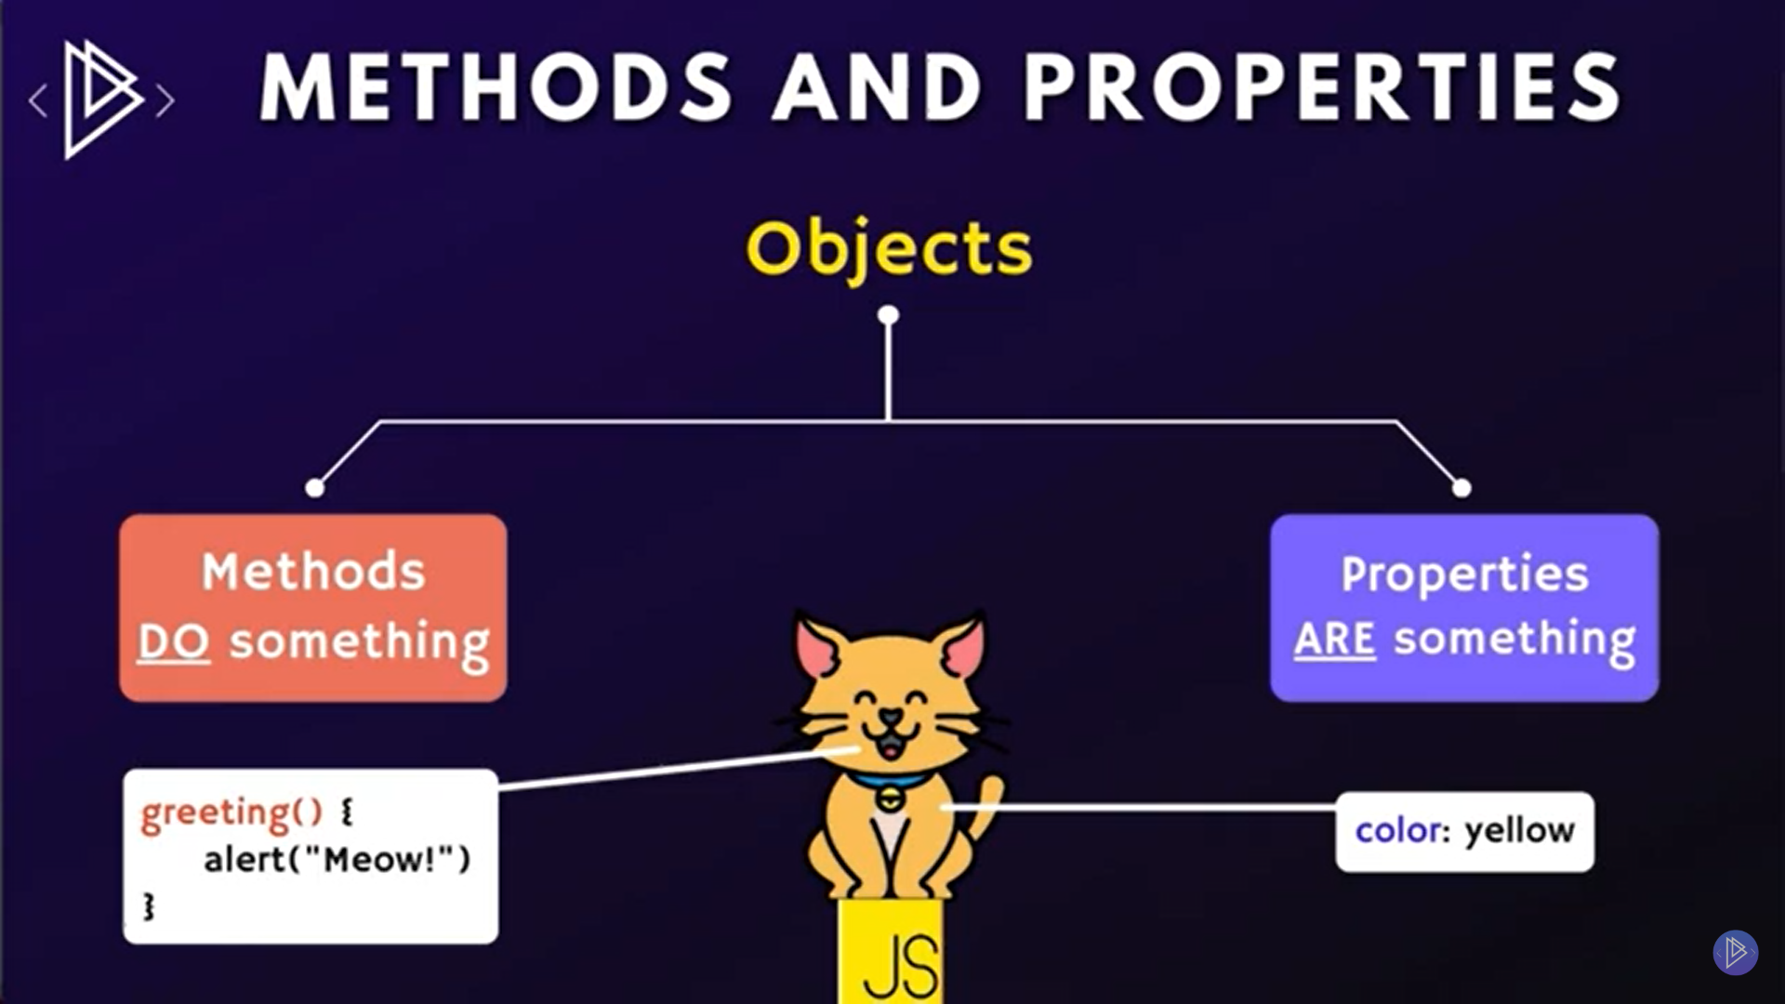
Methods and Properties

Slide 5
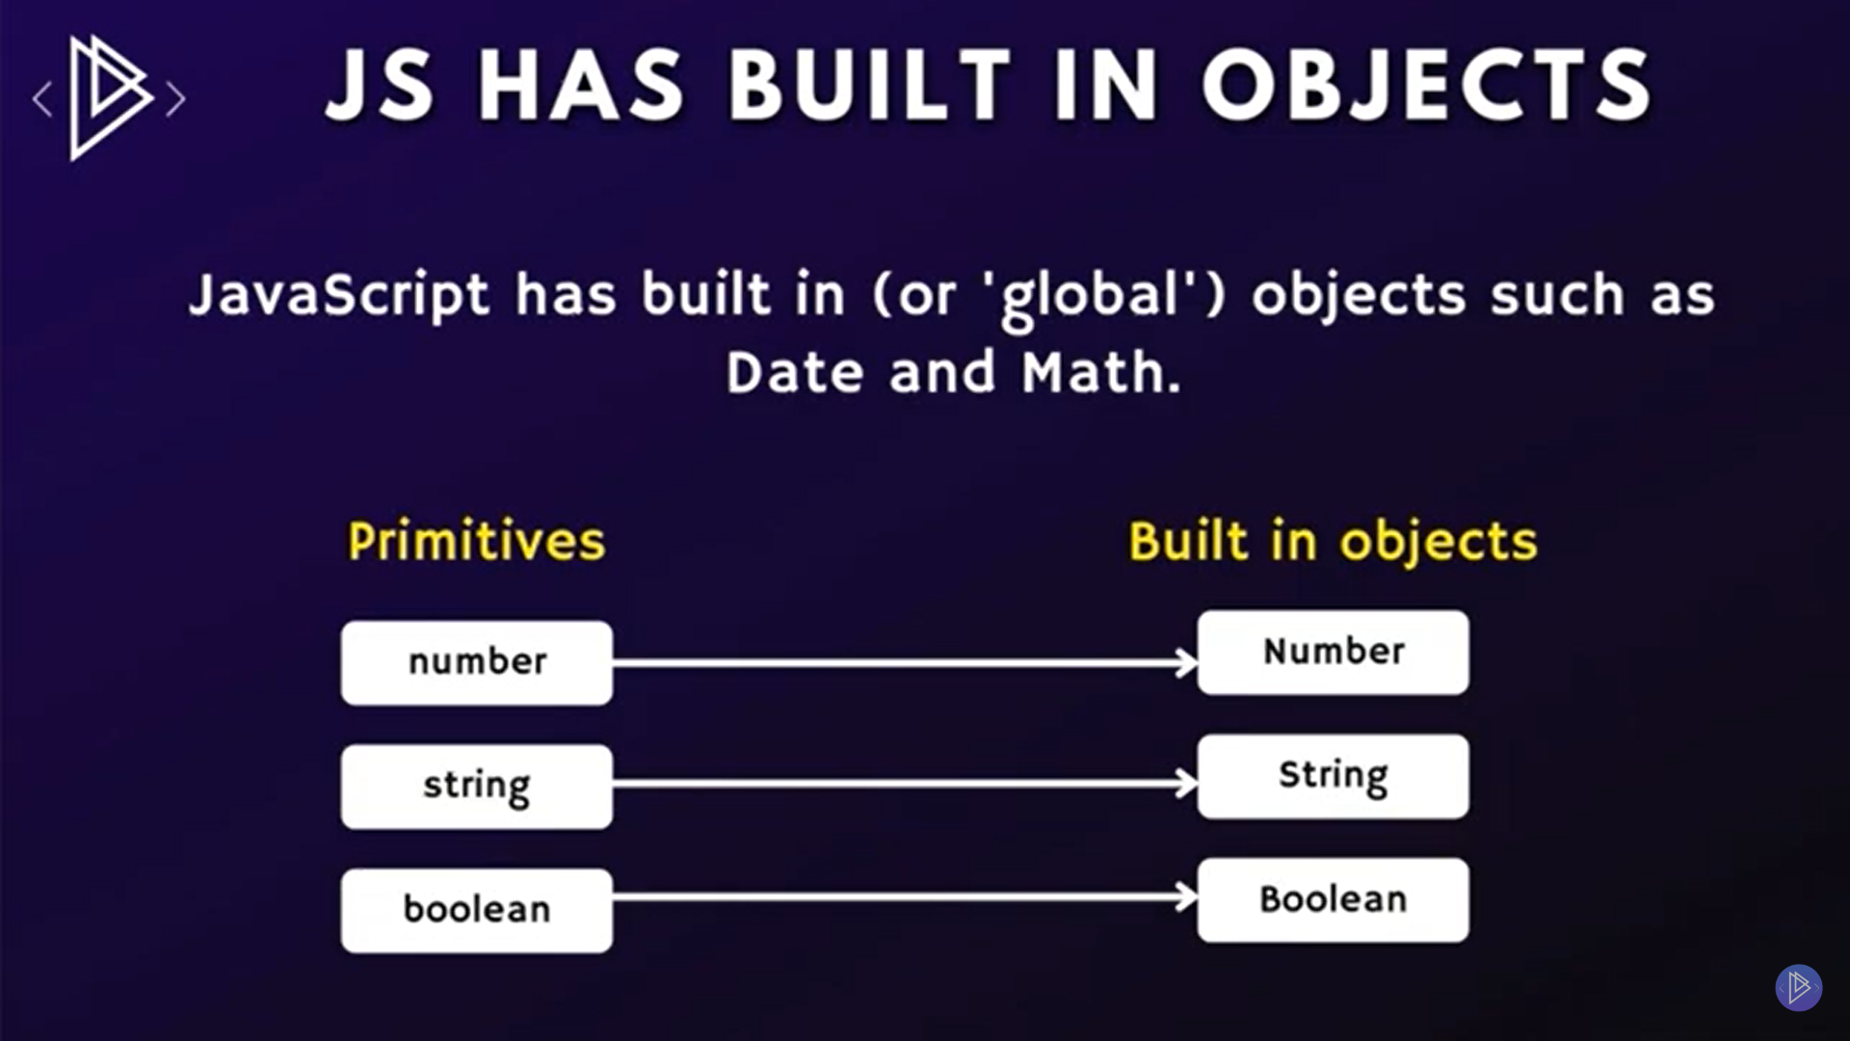
Built in Objects

Slide 6
JS Numbers
Tofixed()
Toprecision()
Toexponentional
Parseint()
Parsefloat()
toString()

Slide 7
Math Methods
alert(Math.PI * 1)
alert(Math.trunk * 1) remove decimal
console.log(Math.round(2.4)) roundoff
console.log(Math.ceil(2.6)) high
console.log(Math.floor(2.6)) low
console.log(Math.pow(2,3)) power of
console.log(Math.sqrt(2).toFixed(2)) square roort
console.log(Math.abs(-2,4))
console.log(Math.max(-2,4))
console.log(Math.min(-2,4))

Slide 8
JS Strings
Double quotes “”
Single Quotes ‘’
Back Ticks ` `
Use of backslash \’
\n new line
\\ Backslash
\t Tab
Concatentate
Length
Index

Slide 9
String Methods
.length()
.trim()
.toUpperCase()
.toLowerCase()
.indexof()
.lastindexof()
.startwith()
.includes()
.slice()
.replace()
.charAt()

Slide 10
JS Date Object
let curentDate = new Date();
.getDate()
.getDay()
getHours()
getFullYear()
getMinutes()
getSeconds()
getTime()
toLocaleString()

Slide 11
Thanks!
Do you have any questions?
umairazmat8115@gmail.com
+923217061116 umairazmat.me

